Slide 1


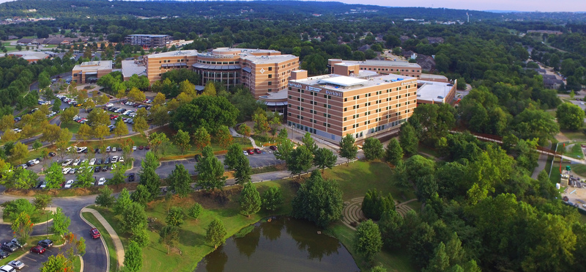
DIRECT-TO-EMPLOYER PLAN
WASHINGTON REGIONAL MEDICAL SYSTEM

Slide 2



Founded in 1979 and headquartered in Indianapolis, IN​
Full-service TPA specializing in the administration of self-funded health plans and population health management​
One of the country’s largest independently-owned TPAs
The Key Family is a commonly-held group of benefits related organizations with:​
3,000+ corporate clients​
3.0 million members under management​
700 Employees
Exclusive Relationships
We know The Market – Agents, Networks, and MGAs

Slide 3


Healthcare Leader in Private Labeled DTE Plans
Louisville, KY
OneHealth Plan
Cincinnati, OH
TCH Optimal
Bentonville, AR
Northwest Health Plan
Knoxville, TN
East Tennessee Health Plan
Meridian, MS
Affinity Health Plan
Fort Myers, FL
Lee Health Care Partners

Slide 4
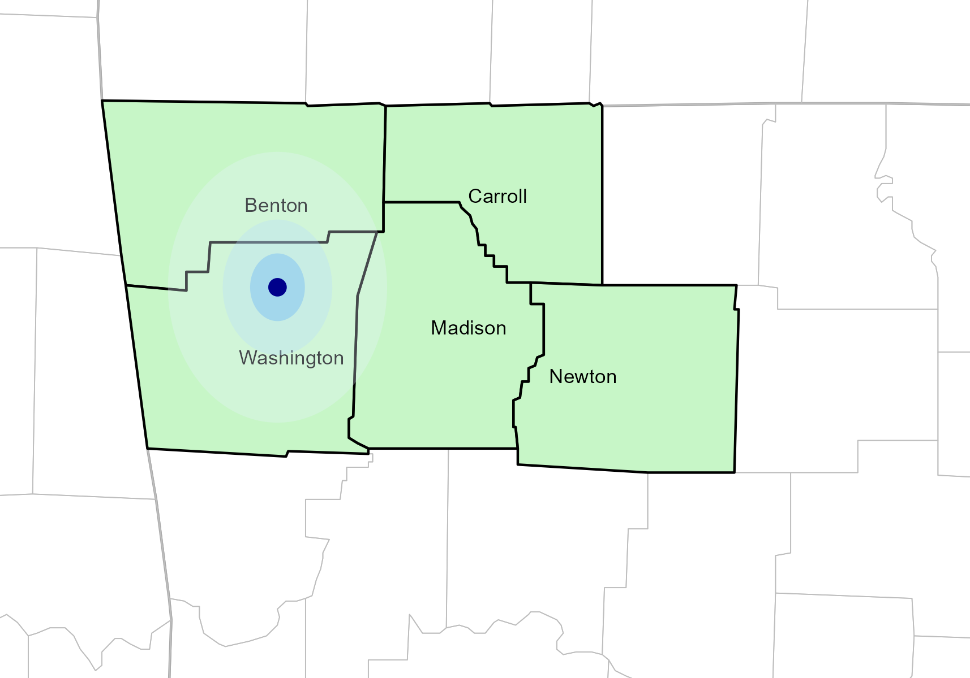
Significant Opportunity for Plan Growth Researched for Washington, Benton, Carroll, Madison, and Newton Counties
Target Market 500+ Employers 100,000+ Employees 180,000+ Members
 | Employer Size Group (# of Employees)
Commercial Employers With Headquarters | 50-100 | 101-200 | 201-400 | 401-1,000 | 1,001-3,000 | 3,000+
In Catchment Area | 280 | 127 | 81 | 38 | 15 | 11
Total Employees at Employers | 50-100 | 101-200 | 201-400 | 401-1,000 | 1,001-3,000 | 3,000+
Headquartered in Catchment Area | 21,000 | 19,050 | 24,300 | 26,600 | 30,000 | 2M+
Total Members with Employers | 50-100 | 101-200 | 201-400 | 401-1,000 | 1,001-3,000 | 3,000+
Headquartered in Catchment Area | 37,800 | 34,290 | 43,740 | 47,880 | 54,000 | 4M+

Slide 5
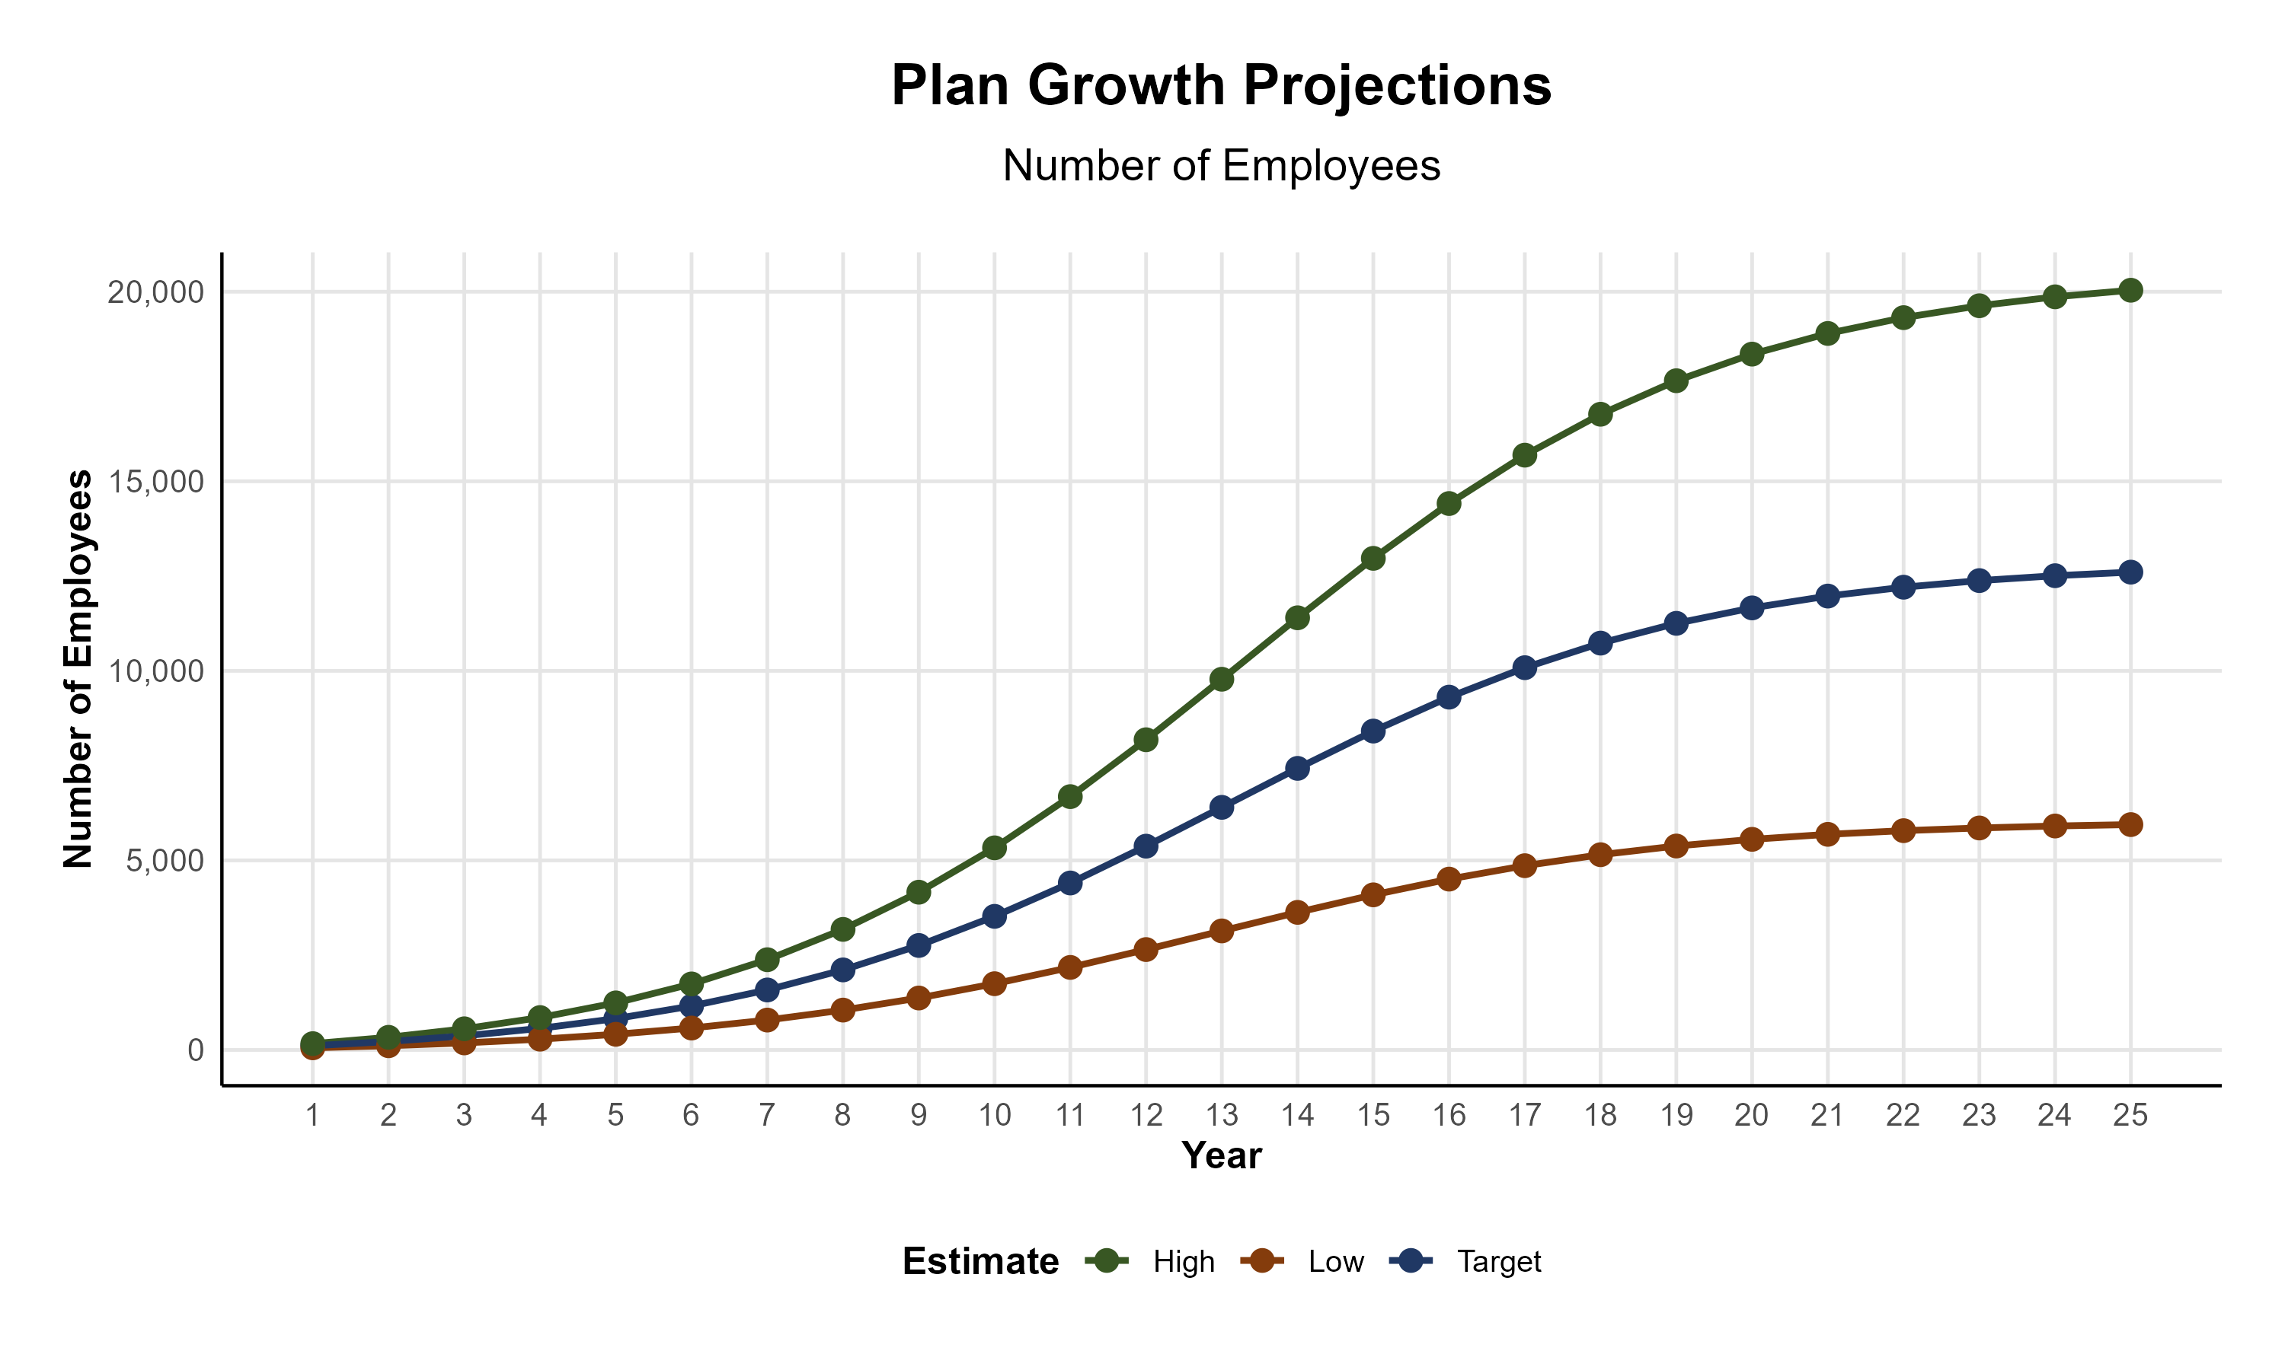
Plan Potential Growth Paths
Self Funded
167K
PLAN GROWTH POTENTIAL
281K
Insured
Working Age
412K
Population
698K
Estimates include Benton, Carroll, Madison, Newton, and Washington Counties

Slide 6

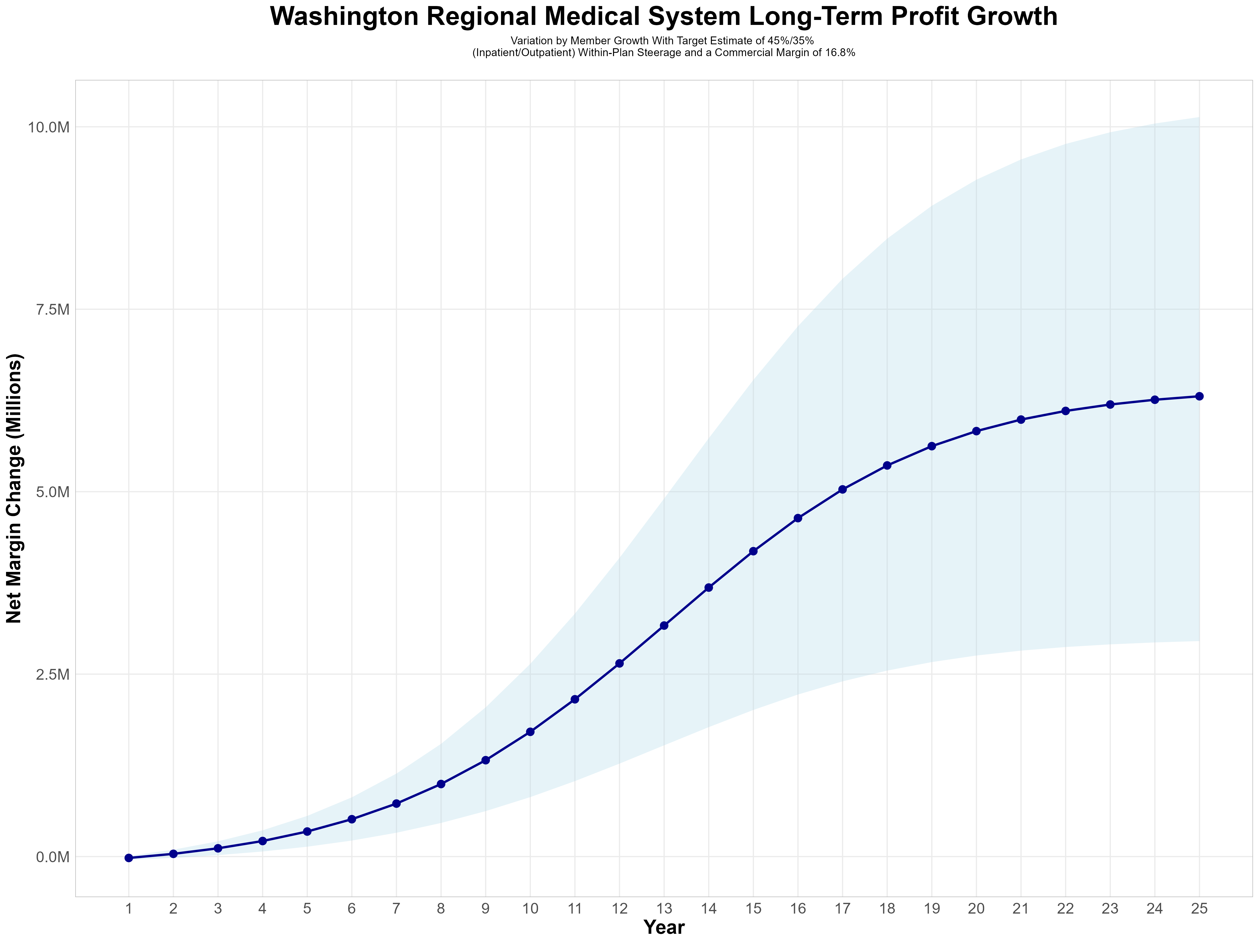
Growing Powerful, Lasting Profitability
Early Stage
Graining Name Recognition, Early Growth
New Revenue:
New Profit:
$2.57M
$0.37M
Growth Stage
Strong Reputation, Strong Growth
New Revenue:
New Profit:
$17.62M
$2.94M
Mature Stage
High Profitability, Market Saturation
New Revenue:
New Profit:
$34.67M
$5.86M

Slide 7
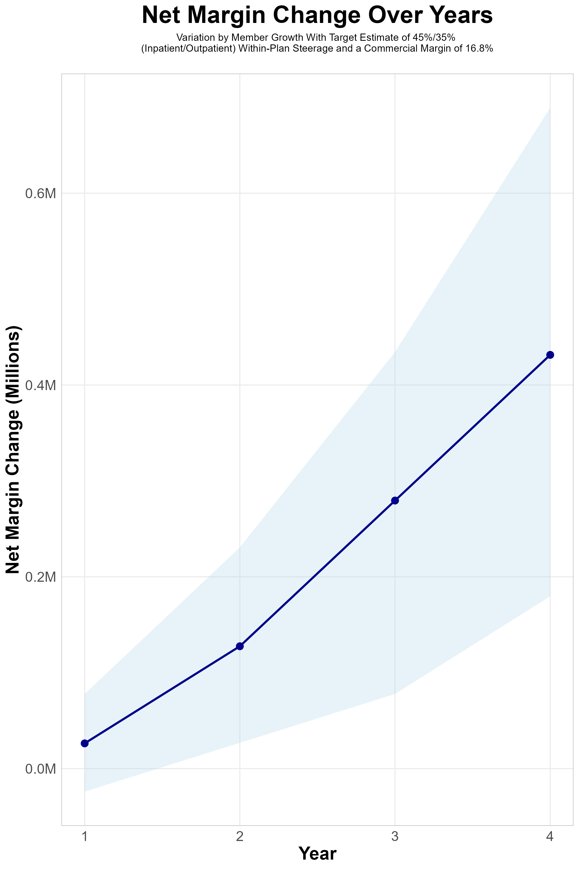
FOUR-YEAR PROJECTIONS
Target Member Growth | Target Member Growth | Target Member Growth | Target Member Growth | Target Member Growth
Metric | Year 1 | Year 2 | Year 3 | Year 4
Number of Members | 200 | 400 | 700 | 1,000
Incremental Margin | 100.7K | 201.4K | 352.4K | 503.4K
Network Access Fee | 1.2K | 2.4K | 4.2K | 6.0K
Implementation Fee (Waved) | 0.0K | 0.0K | 0.0K | 0.0K
Sales and Marketing Costs | -75.0K | -75.0K | -75.0K | -75.0K
Net Margin Change | 26.3K | 127.6K | 279.5K | 431.4K
High Member Growth | High Member Growth | High Member Growth | High Member Growth | High Member Growth
Metric | Year 1 | Year 2 | Year 3 | Year 4
Number of Members | 300 | 600 | 1,000 | 1,500
Incremental Margin | 151.0K | 302.1K | 503.4K | 755.1K
Network Access Fee | 1.8K | 3.6K | 6.0K | 9.0K
Implementation Fee (Waved) | 0.0K | 0.0K | 0.0K | 0.0K
Sales and Marketing Costs | -75.0K | -75.0K | -75.0K | -75.0K
Net Margin Change | 77.8K | 230.7K | 434.4K | 689.1K
Low Member Growth | Low Member Growth | Low Member Growth | Low Member Growth | Low Member Growth
Metric | Year 1 | Year 2 | Year 3 | Year 4
Number of Members | 100 | 200 | 300 | 500
Incremental Margin | 50.3K | 100.7K | 151.0K | 251.7K
Network Access Fee | 0.6K | 1.2K | 1.8K | 3.0K
Implementation Fee (Waved) | 0.0K | 0.0K | 0.0K | 0.0K
Sales and Marketing Costs | -75.0K | -75.0K | -75.0K | -75.0K
Net Margin Change | -24.1K | 26.9K | 77.8K | 179.7K

Slide 8
SINGLE YEAR SUMMARY
DTE Covered Members Financial Analysis | DTE Covered Members Financial Analysis | DTE Covered Members Financial Analysis | DTE Covered Members Financial Analysis | DTE Covered Members Financial Analysis | DTE Covered Members Financial Analysis | DTE Covered Members Financial Analysis | DTE Covered Members Financial Analysis
Target Estimate of 45%/35% (Inpatient/Outpatient) Within-Plan Steerage and a Commercial Margin of 16.8% (Conservatory Modeled at 80% of Observed Margin) | Target Estimate of 45%/35% (Inpatient/Outpatient) Within-Plan Steerage and a Commercial Margin of 16.8%. | Target Estimate of 45%/35% (Inpatient/Outpatient) Within-Plan Steerage and a Commercial Margin of 16.8%. | Target Estimate of 45%/35% (Inpatient/Outpatient) Within-Plan Steerage and a Commercial Margin of 16.8%. | Target Estimate of 45%/35% (Inpatient/Outpatient) Within-Plan Steerage and a Commercial Margin of 16.8%. | Target Estimate of 45%/35% (Inpatient/Outpatient) Within-Plan Steerage and a Commercial Margin of 16.8%. | Target Estimate of 45%/35% (Inpatient/Outpatient) Within-Plan Steerage and a Commercial Margin of 16.8%. | Target Estimate of 45%/35% (Inpatient/Outpatient) Within-Plan Steerage and a Commercial Margin of 16.8%.
DTE Members | Pre-DTE Revenue | Pre-DTE Margin | DTE Revenue | DTE Incr. Revenue | DTE Total Margin | DTE Incr. Margin | Net Margin Less DTE Fees
100 | $ 163K | $ 27K | $ 459K | $ 296K | $ 77K | $ 50K | $ -25K
500 | $ 813K | $ 137K | $ 2,294K | $ 1,480K | $ 385K | $ 249K | $ 177K
1,000 | $ 1,626K | $ 273K | $ 4,587K | $ 2,961K | $ 771K | $ 497K | $ 428K
2,500 | $ 4,066K | $ 683K | $11,468K | $ 7,402K | $ 1,927K | $1,244K | $1,184K
10,000 | $16,263K | $2,732K | $45,872K | $29,609K | $ 7,706K | $4,974K | $4,959K
20,000 | $32,525K | $5,464K | $91,744K | $59,218K | $15,413K | $9,949K | $9,994K
NOTE: Please see detailed financial analysis and assumptions used starting on page 23.
Financial projections do not include 340B contribution margin, which could represent $136 PMPM by optimizing 340B through Rx plan design, Washington Regional Medical System’s approved site(s) with network integration, and development of Washington Regional Medical System’s proprietary PBM program.

